Slide 1
Usage of Stack
Consider a mathematical expression that includes several sets of nested parenthesis.
7 – ((x * (( x + y) / (j - 3)) + Y) / (4 – 2))
In expression we want to check
  There are an equal number of right and left parenthesis.
  Every right parenthesis is preceded by a matching left parenthesis.
  Expressions like ((A+B) or A+B( violates condition 1 and expressions like )A + B(-C violate condition 2.
  Nested Depth: is the number of scopes that have been opened and not yet closed.
  Parenthesis count: no of left parenthesis – no of right parenthesis.

Slide 2
Usage of Stack
Expression id valid if following conditions are met.
  Parenthesis count at end should be zero.
  Parenthesis count at each point in expression should be non negative.
  7 – ( ( x * ( ( x + y ) / ( j - 3 ) ) + Y ) / ( 4 – 2.5 ) )
  0 0 1 2 2 2 3 4 4 4 4 3 3 4 4 4 4 3 2 2 2 1 1 2 2 2 2 1 0
  ( ( A + B ) and (A + B] is illegal
  1 2 2 2 2 1

Slide 3
Algorithm for Example
valid = true
s = empty stack;
while (we have not read the entire string) {
read the next symbol (symb) in the string;
if (symb == ‘(’ || symb == ‘{’ || symb == ‘[’ )
s.push(symb);
if (symb == ‘)’ || symb == ‘}’ || symb == ‘]’ )
if (empty(s))
valid = false;
else{
i = s.pop();
if (i is not the matching opener of symb)
valid = false }
}// end of while
if (!s.empty()) valid = false;
if (valid)
cout << “String is valid”;
else cout << “String is not valid”;

Slide 4
Parenthesis Stack
Consider expression
[x + {y – (a + b)}]
(
{
{
{
[
[
[
[
[ x+{
[ x+{y-(
[ x+{y-(a+b)
[
[
[ x+{y-(a+b)}
[ x+{y-(a+b)}]

Slide 5
Polish Notations
Expression can be written in prefix, postfix or infix notations
+ A B prefix operator precedes operands
A B + postfix operator precedes operands
A + B infix
Unlike Infix notation no parenthesis are required to enforce precedence.
Expressions are evaluated from left to right.

Slide 6
Converting to Prefix, Postfix Notation
Precedence rules are used to convert expression
1) Exponentiation, 2. Multiplication/ Division 3. Addition/Subtraction
Converting to Prefix Notation
(A+B)*C = [+AB]*C = *+ABC
A+(B*C) = A+[*BC) = +A*BC
(A+B)/(C-D) = [+AB]/[-CD] = /+AB-CD
Converting to Postfix Notation
A+B = AB+
(A+B)*C = [AB+]*C = AB+C*
A+(B*C) = A+[BC*] =ABC*+

Slide 7
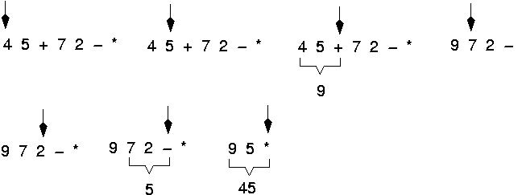
Example: postfix expressions
(cont.)

Slide 8
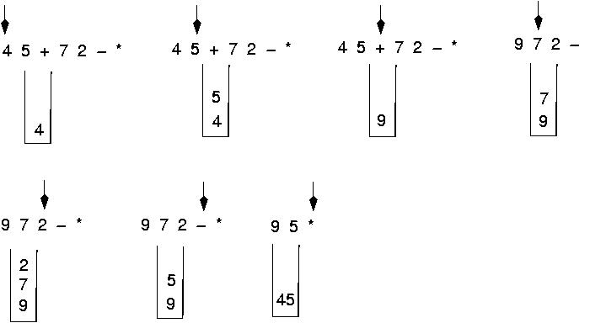
Postfix expressions: using stacks (cont.)

Slide 9
Postfix expressions: Algorithm using stacks (cont.)
opndstk = the empty stack;
while (not end of input){
symb = next input character;
if (symb is an operand)
opndstk.push(symb);
else{
opnd2 = opndstk.pop();
opnd1 = opndstk.pop();
value = result of applying symb to opnd1 and opnd2;
opndstk.push(value) }

Slide 10
EXERCISE
6 2 3 + - 3 8 2 / + * 2 $ 3 +
symb
op1
op2
value
opndstk
6
2
3
+
-
3
8
2
/
+
*
2
$
3
+
6
6 2
6 2 3
6 5
1
1 3
1 3 8
1 3 8 2
1 3 4
1 7
7
7 2
49
49 3
52
2
6
6
6
6
8
3
1
1
7
7
49
3
5
5
5
5
2
4
7
7
2
2
3
5
1
1
1
1
4
7
7
7
49
49
52

Slide 11
Algorithm to Convert Infix Exp to Postfix Expression
1. opstk = the empty stack;
2. while (not end of input){
3. symb = next input character;
4. if (symb is an operand)
add symb to the postfix string
5. else{
6. while (!opstk.empty () && prcd(opstk.Top(), symb)){
7. topsymb = opstk.pop();
8. add topsymb to the postfix string;
} /* end while*/
9. opstk.push(symb);
} /* end else*/
} /* end while*/
10. while (!opstk.empty()){
11. Topsymb = opstk.pop();
12. add topsymb to the postfix string;
} /* end while*/

Slide 12
EXERCISE
A + B * C
symb
Postfix string
opstk
A
+
B
*
C
A
A
AB
AB
ABC
ABC*+
+
+
+ *
+*

Slide 13
EXERCISE
A * B + C
symb
Postfix string
opstk
A
*
B
+
C
A
A
AB
AB*
AB*C
AB*C+
*
*
+
+

Slide 14
Algorithm to Convert Infix Exp to Postfix Expression
9. if (opstk.empty () || symb != ‘)’)
opstk .push(symb);
else
topsymb = opstk.pop();
Precedence rules for parenthesis:
prcd(‘(’,op) = FALSE
Prcd(op,’(’) = FALSE
prcd(op,’)’) = TRUE
prcd(‘)’,op) = undefined

Slide 15
Evaluation of Expressions
Consider the following infix expression
A+(B*C-(D/E$F)*G)*H
Convert into Postfix using Stack
Symb postfix string opstk
A
+
(
B
*
C
-
(
D
/
E
^
F
)
*
G
)
*
H
A
A
A
A B
A B
A B C
A B C *
A B C *
A B C * D
A B C * D
A B C * D E
A B C * D E
A B C * D E F
A B C * D E F ^ /
A B C * D E F ^ / G
A B C * D E F ^ / G * -
A B C * D E F ^ / G * -
A B C * D E F ^ / G * - H
A B C * D E F ^ / G * - H * +
+
+ (
+ (
+ ( *
+ ( *
+ ( -
+ (- (
+ ( - (
+ ( - ( /
+ ( - ( /
+ (- ( /^
+ ( - ( / ^
+ ( -
+ ( - *
+ ( - *
+
+ *
+ *

Slide 16
Evaluation of Expressions
Consider the following infix expression
X+Y*Z/U-V+X^W
Convert into Postfix using Stack
symb postfix string opstk
X X
+ X +
Y X Y +
* X Y + *
Z X Y Z + *
/ X Y Z + * /
U X Y Z U + * /
- X Y Z U / * + -
V X Y Z U / * + V -
+ X Y Z U / * + V - +
X X Y Z U / * + V X - +
^ X Y Z U / * + V X - + ^
W X Y Z U / * + V X W - + ^
X Y Z U / * + V X W ^ + -

Slide 17
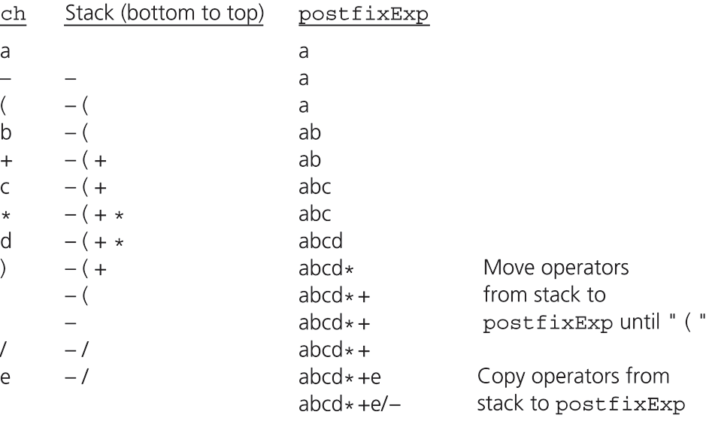
Converting Infix Expressions to Equivalent Postfix Expressions
A trace of the algorithm that converts the infix expression a - (b + c * d) /e to postfix form

